Slide 1


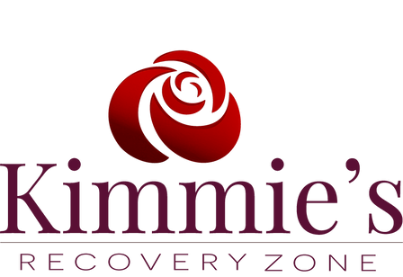







Recovery Should Never Be the Exception
Recovery Should Be The Expectation
https://www.kimmiesrecoveryzone.org/ 507 Center Road, Fort Myers, FL

Slide 2




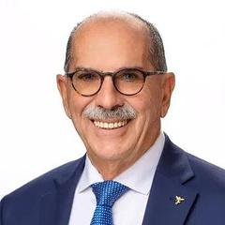
Who are we?
A Recovery Community Organization (RCO), an independent, non-profit organization led and governed by representatives of local communities of recovery. These organizations organize recovery-focused policy advocacy activities, carry out recovery-focused community education and outreach programs, and/or provide peer-based recovery support services.
Al Kinkle
Founder/ President
Kimmie’s Recovery Zone

Slide 3
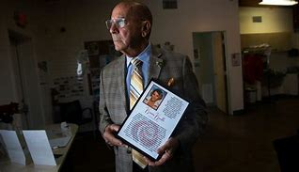
Kimmie’s Changes a Community
Kimmie's Link

Slide 4
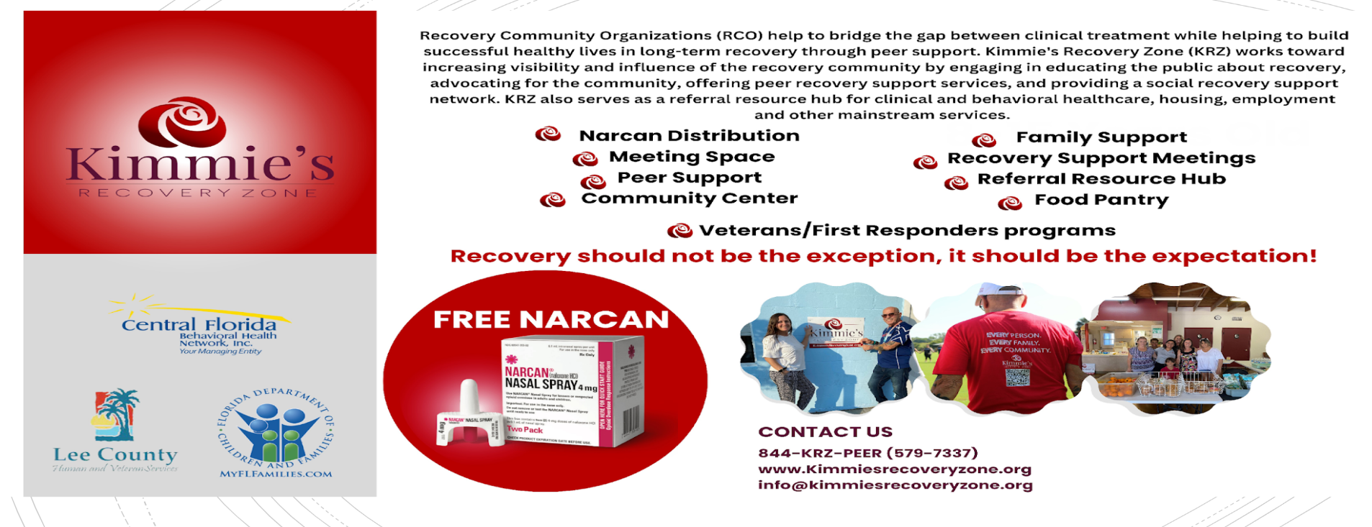




Slide 5

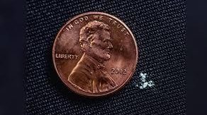
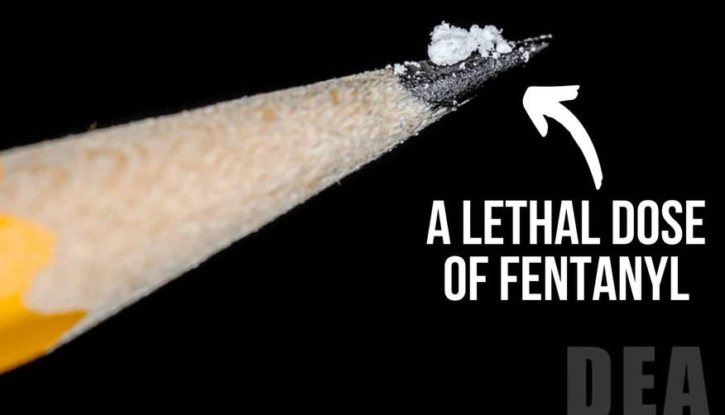
Wanted for Murder: Fentanyl
United States
For Americans aged 18-45, fentanyl overdose is the leading cause of death. This potent drug, 50 times stronger than heroin and 100 times stronger than morphine, is responsible for nearly 70% of the over 108,000 drug overdose deaths in the U.S. in 2022. Illicit Manufactured Fentanyl is the primary driver of the recent increase in overdose deaths.
(Source: CDC Wonder)

Slide 6
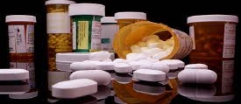
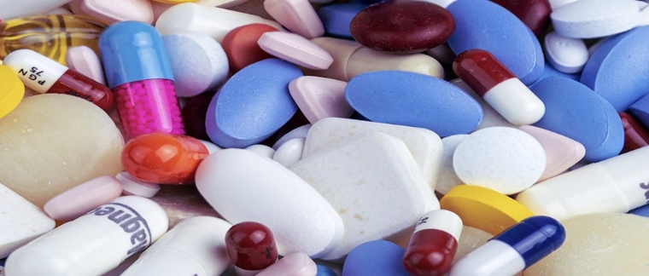
Record-Breaking Fentanyl Seizures by DEA in 2023
In 2023, the DEA seized over 77 million fentanyl pills and nearly 12,000 pounds of fentanyl powder across the United States.
This marks the highest amount of fentanyl seized by the DEA in a single year.
The total seizure amounts to more than 386 million potentially deadly doses of fentanyl.
This quantity is enough to kill every American.
Source: Year in Review: DEA Innovates to Fight Fentanyl.

Slide 7
OPIOID STATISTICs
In 2022, the DEA reported that 6 out of 10 fake prescription pills analyzed contained a potentially lethal dose of fentanyl.
In 2023, an estimated 107,543 people died from drug overdoses in the United States, a slight decrease from 2022. The majority of these deaths were linked to opioids, particularly synthetic opioids like fentanyl, which caused over 81,000 deaths. Despite the overall decrease in overdose deaths, fentanyl remains a dominant factor in the ongoing opioid crisis​.
In 2023, Lee County, Florida experienced 243 deaths due to opioid overdoses, which includes fentanyl as a primary cause​ (FLHealthCharts)​ (Florida Health Lee).
Currently, in the United States, approximately 220 people die per day from fentanyl and other synthetic opioid overdoses. This is based on data indicating over 81,000 fentanyl-related deaths annually​ (Addiction Group)​ (CDC)​ (American Medical Association).
On August 13, 2024, Cape Coral Police Department seized 86 white tablets with the marking "I 10" which is usually indicated on ibuprofen.

Slide 8
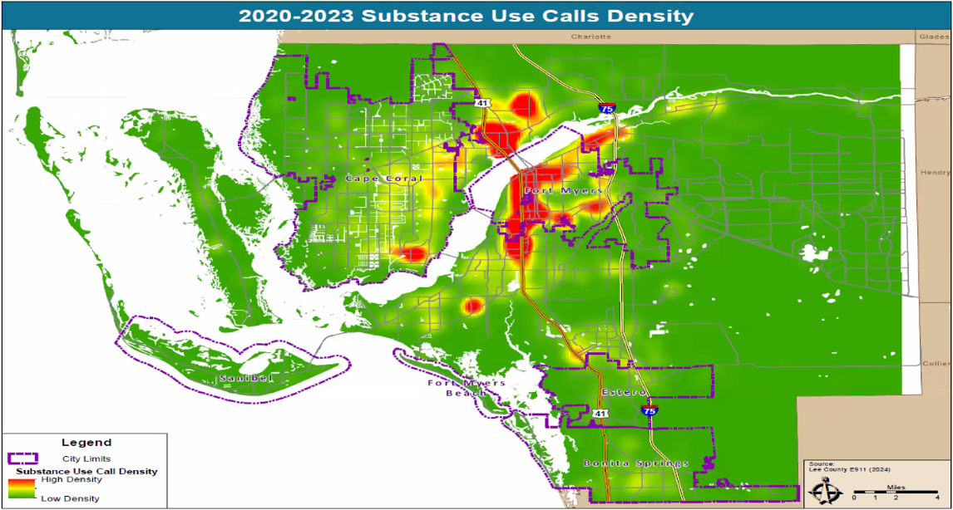
Substance Use Calls Density in Lee County
(2020-2023)

Slide 9
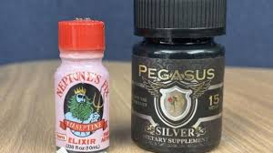
Emerging Designer Drugs and Street Names:
A Closer Look at Tianeptine
Tianeptine (Gas Station Heroin)
  Description: Tianeptine, commonly referred to as "Gas Station Heroin," is an antidepressant with opioid-like effects.
  Street Names: Often sold under names like ZaZa, Tianna, and Red Dawn.
  Availability: Easily found in gas stations and convenience stores across the U.S. and online.
  Risks: High potential for addiction and abuse, withdrawal symptoms, and risk of overdose.
  Source for More Information: NBC News Report
Substances such as this represents a growing challenge in the realm of public health and drug enforcement, highlighting the need for increased awareness and regulation. NARCAN WILL REVERSE AN OVERDOSE OF TIANEPTINE

Slide 10
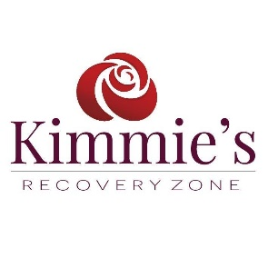
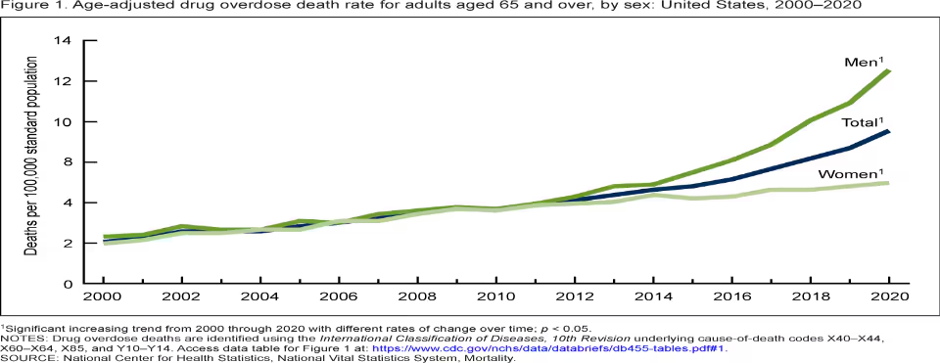
As a result of chronic pain, older adults may use prescription opioids for a long time, which presents a risk for developing an opioid use disorder. In addition, as people age, medications affect them more strongly and are slower to leave their systems so the side effects of opioids can be severe.
Seniors at risk:
*Adults aged 65 and over experienced the largest percentage increase in drug overdose death rates from 2020 through 2021, with a 28% increase.*
National Institutes of Health 2021

Slide 11
HIGH SCHOOL-AGED YOUTH
Fentanyl-related overdoses among high school-aged youth have become a significant public health concern in the United States. Although exact numbers can vary by source and over time, data from the Centers for Disease Control and Prevention (CDC) and other health organizations have reported alarming increases in fentanyl-related overdoses among young people, particularly during the COVID-19 pandemic.
As of the latest available data:
In 2021, fentanyl was involved in over 77% of adolescent (ages 14-18) overdose deaths in the U.S.
In 2022, over 1,000 teens aged 15-19 died from fentanyl-related overdoses, marking a 182% increase from 2019.
The CDC and other public health entities continue to monitor this issue closely, as the rise in synthetic opioids like fentanyl has significantly impacted youth and young adults.

Slide 12
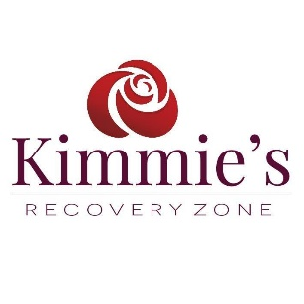
Some general statewide trends for the first half of 2022 (January – June) are listed below. All comparisons are made to January - June 2021 data unless otherwise noted
3,969 opioid-related deaths were reported, which is a 7 percent decrease (313 less).
3,003 opioid-caused deaths were reported, which is a 10 percent decrease (333 less).
2022 Medical Examiners Commission Interim Drug Report
Improved access to treatment and recovery services along with the distribution of Narcan appears to be working towards decreasing overdose deaths!

Slide 13

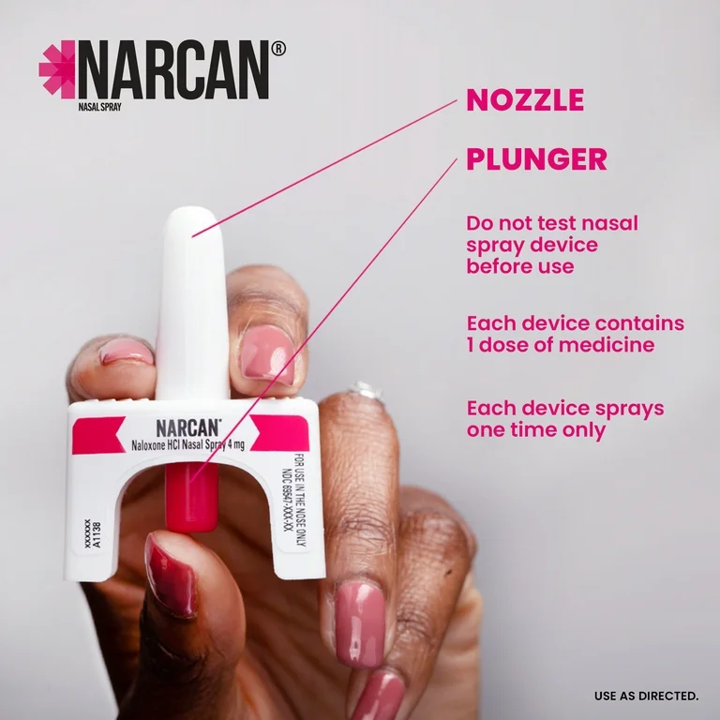
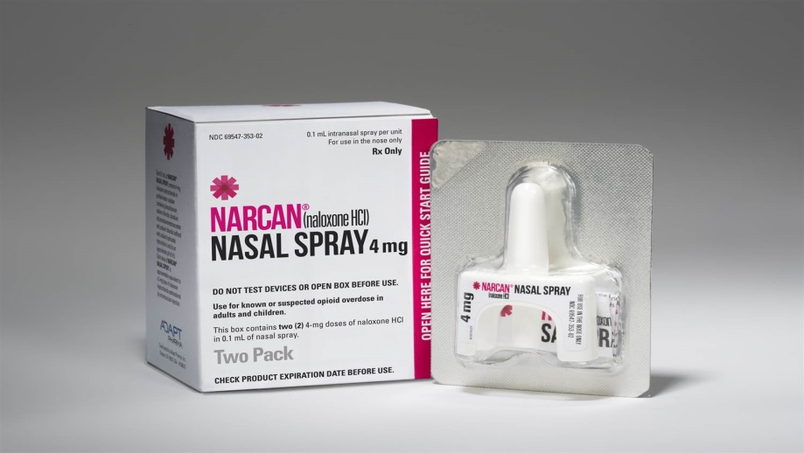
Narcan Nasal Spray
Naloxone saves lives because it can very quickly restore normal breathing to a person whose breathing has slowed or stopped as a result of overdosing on opioid medications, heroin, or other drugs (e.g., cocaine, methamphetamine) that are mixed or laced with the opioid fentanyl.

Slide 14

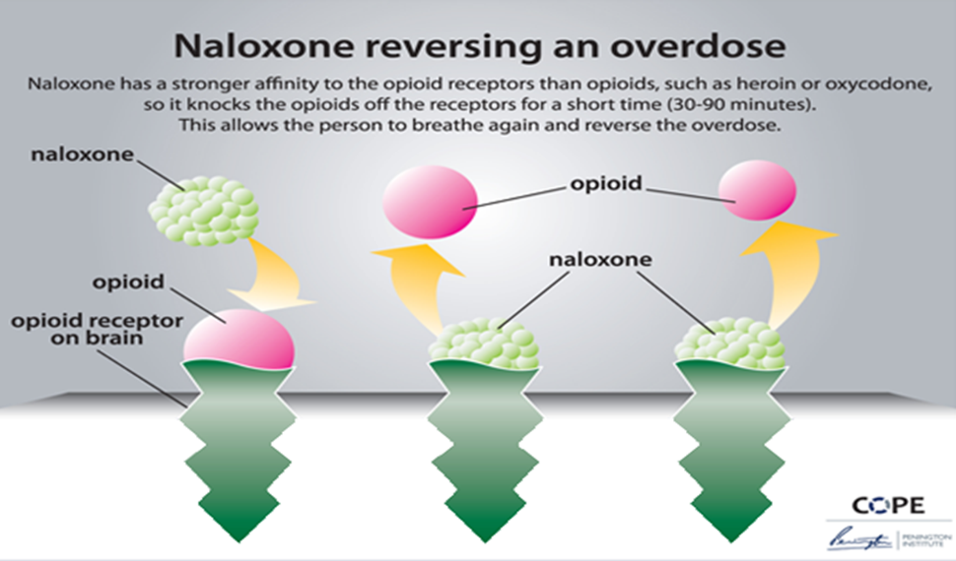
Naloxone

Slide 15
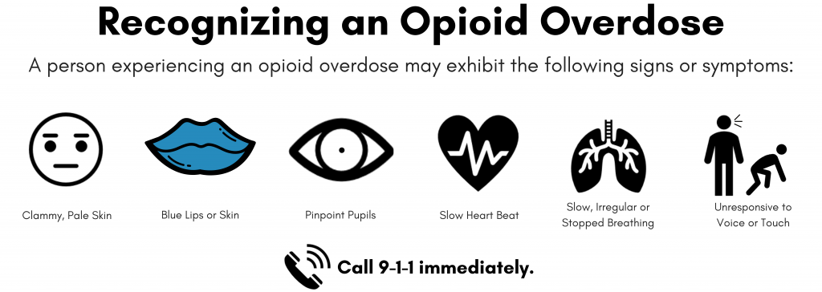
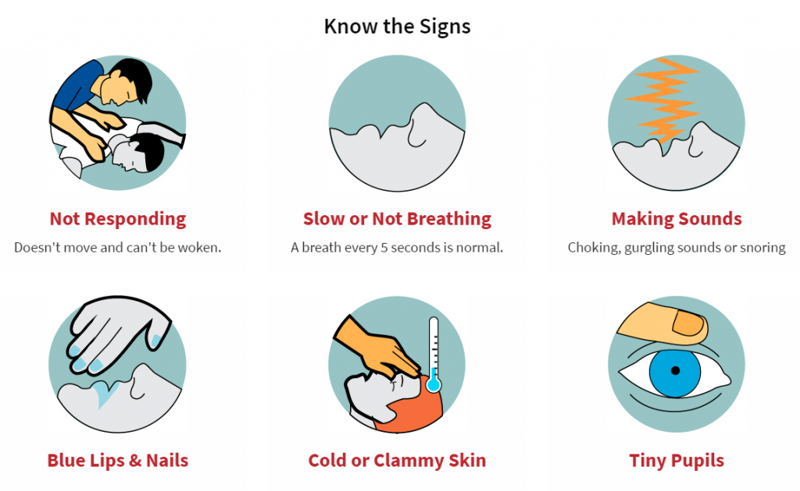

Slide 16
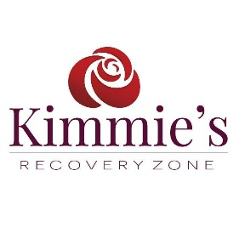
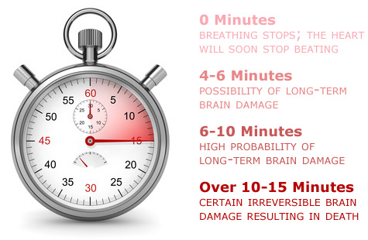
Overdose Progression
Ingestion of excess heroin/opioid
Breathing effort slows
Loss of consciousness
Loss of Consciousness
Slowing of breathing deprives brain, heart, and body of oxygen
Irreversible Damage occurs to brain and other organs
Irreversible damage occurs to brain and other organs
It can take Three to Five Minutes for this to occur
Cardiac arrest occurs
Death
Average response time for EMS arrival is 4-7 minutes

Slide 17
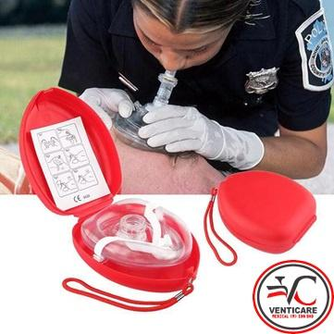
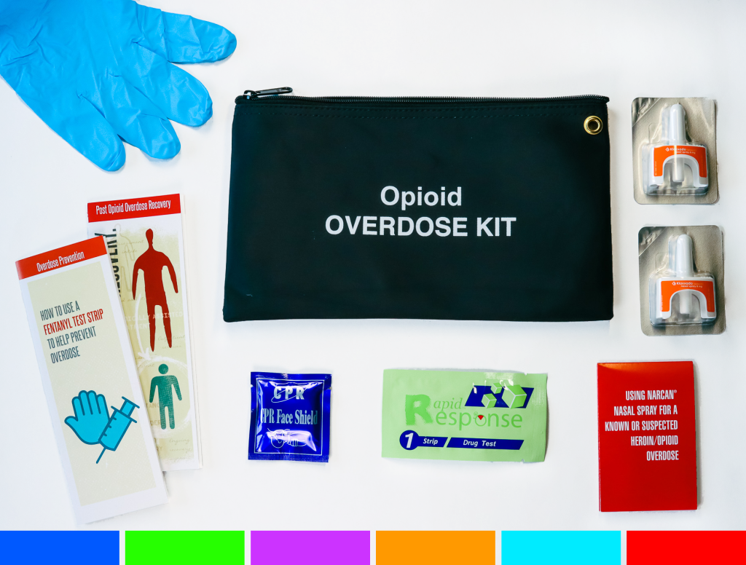
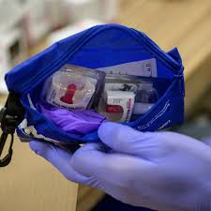
Safety Precautions From
Cross-Contamination

Slide 18
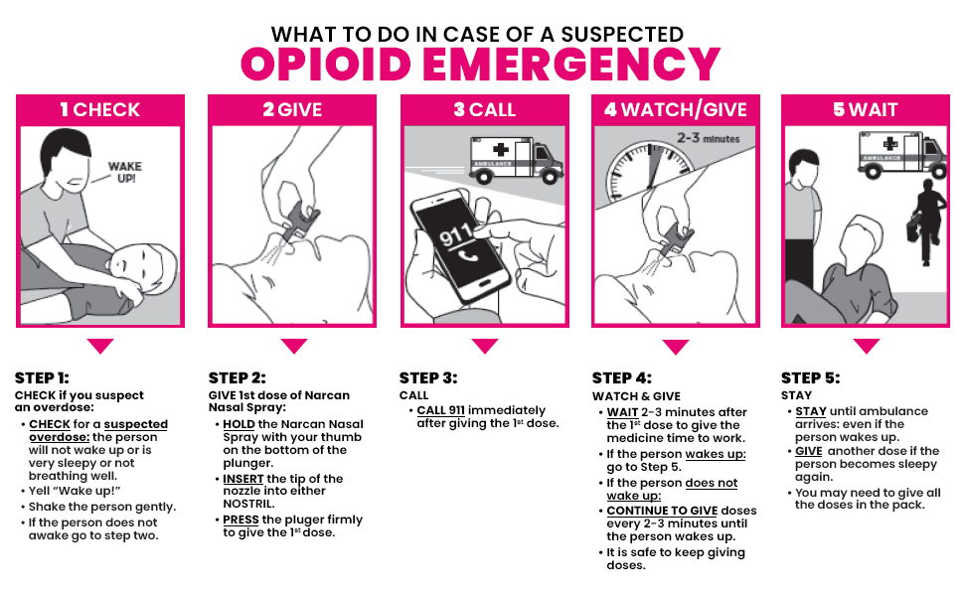
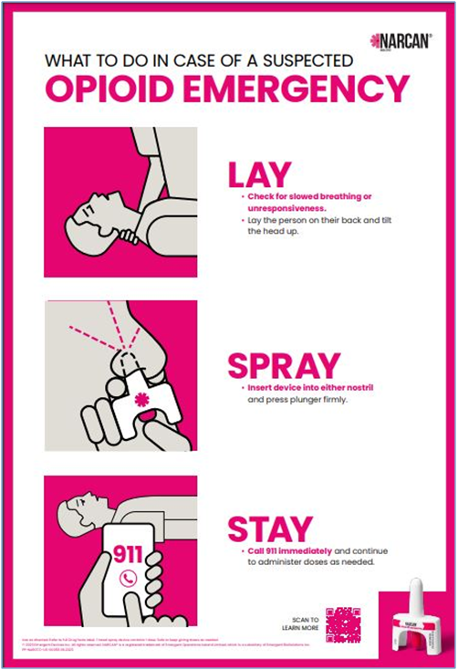
LAY SPRAY STAY
Source: LSS

Slide 19

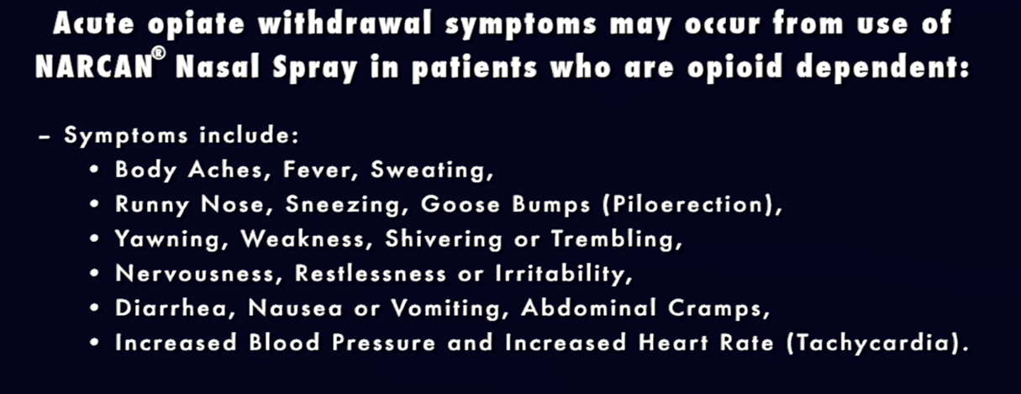
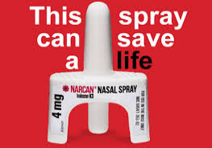
Post-Overdose Recovery

Slide 20


Commonly Asked Questions about Narcan Nasal Spray
Q. Is there any risk if Narcan is used and it’s not an overdose (OD)?
A. No, there is no risk if Narcan is used and it turns out not to be an overdose.
Q. What is the shelf life of Narcan Nasal Spray?
A. The shelf life of Narcan Nasal Spray is typically 2-3 years (24 to 36 months).
Q. What is the recommended storage temperature for Narcan Nasal Spray?
A. Narcan Nasal Spray should be stored at a temperature range of 68 to 77 degrees Fahrenheit It should also be kept away from direct sunlight and not frozen or exposed to excessive heat above 104°F (40°C).

Slide 21

Overview of the Good Samaritan Act
FLA. STAT. 768.13 - Immunity FROM CIVIL LIABILITY
The Good Samaritan law in Florida is designed to protect individuals who provide emergency assistance in good faith from civil liability.

Slide 22
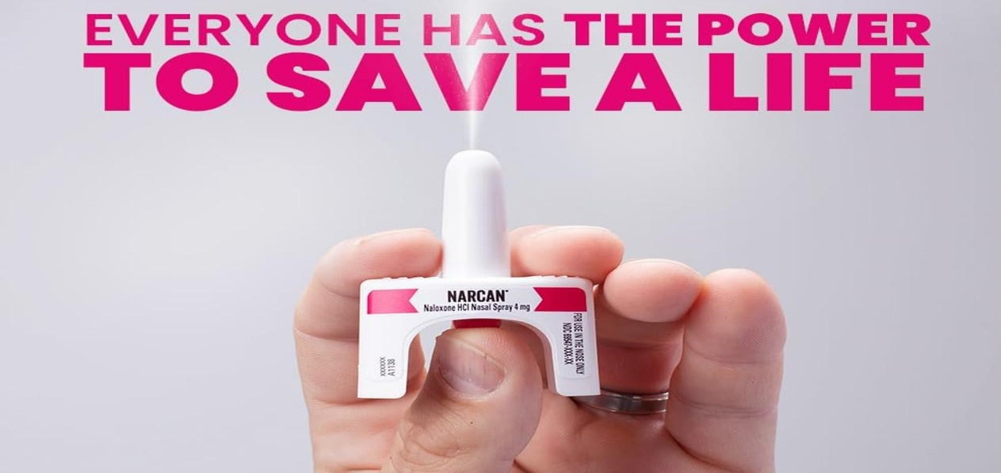
Since 2021
Kimmie’s Recovery Zone has distributed over
40,000 doses of Narcan
KRZ has Received 17 reported reversals in Lee County!

Slide 23

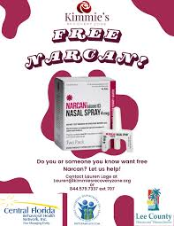
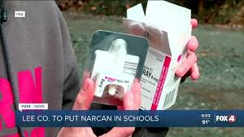
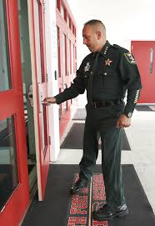
Narcan Implementation and Training in Lee County
Narcan Availability:
KRZ ensured Narcan is available in all schools throughout Lee County.
Narcan was also provided for all of the Sheriff’s vehicles.
Training Initiatives:
Trained all Lee County School Resource Officers.
Trained all school nurses in Lee County.
Trained all school principals in Lee County.
Training for the community!

Slide 24
Harm Reduction: Fentanyl and Xylazine Test Strips
Purpose and Importance:
Designed to detect the presence of fentanyl and xylazine in various samples.
Used for harm reduction to help individuals identify these potent substances in drugs.
Aims to prevent accidental overdoses.
Legislative Actions:
2022: Florida decriminalized the possession and use of fentanyl test strips.
  Part of broader efforts to address the opioid crisis.
  Promotes harm reduction strategies and reduces overdose deaths.
Recent Developments:
2023: Inclusion of xylazine test strips in harm reduction efforts.
  Recognized due to the rising prevalence of xylazine in adulterated drugs, particularly opioids.
  Supports broader legal and public health initiatives to reduce overdose deaths and improve drug safety.
Sources for More Information:
Florida Department of Health: floridahealth.gov
Florida Harm Reduction Collective: flhrc.org
Harm Reduction Coalition: harmreduction.org
National Harm Reduction Coalition: nationalharmreduction.org

Slide 25
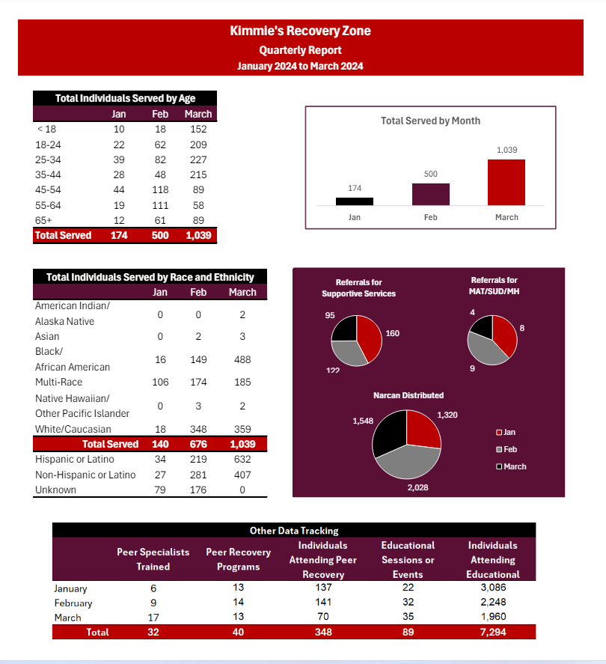
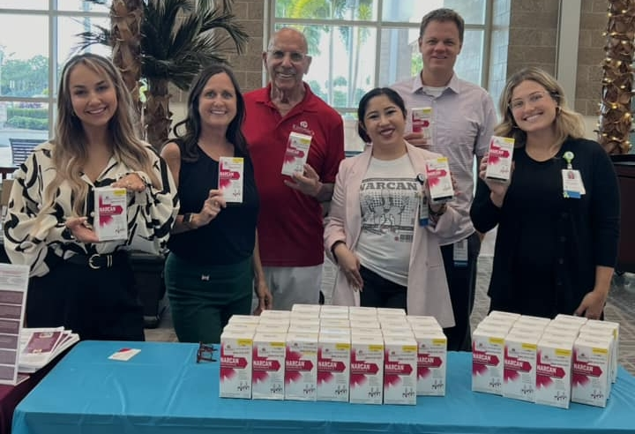
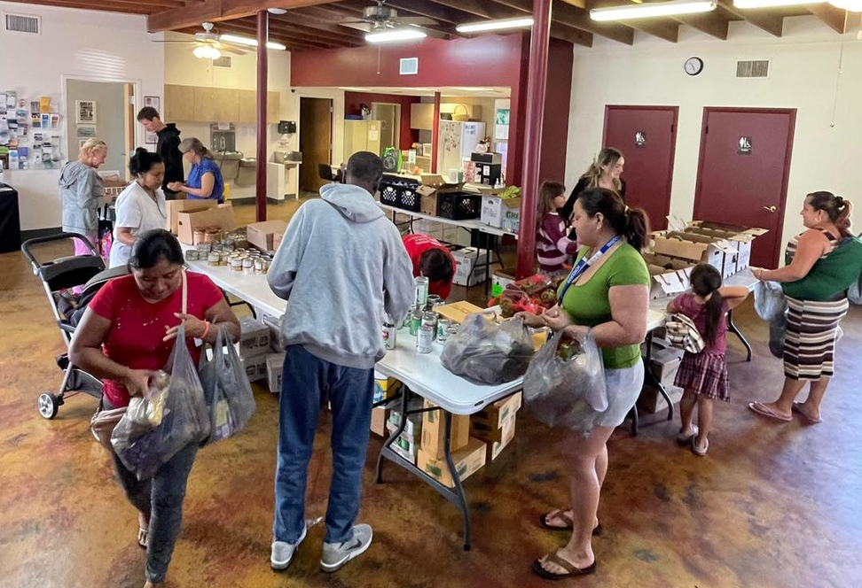

Slide 26
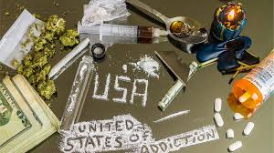
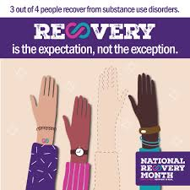

Substance Use Disorder and Recovery
in the United States
Substance Use Disorder Prevalence
29 million Americans identify as having a Substance Use Disorder.
Recovery Statistics
71% of those with a Substance Use Disorder are in recovery.
This translates to 21.3 million Americans currently in recovery.

Slide 27
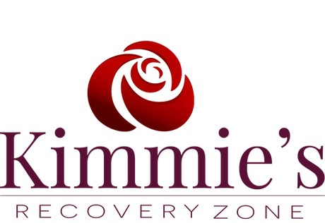


THANK YOU!!!
DO
YOU
HAVE
ANY QUESTIONS???

